Slide 1
Quarterly Sales Performance.
29/07/2024

Slide 2
Project Brief
Situation:
I work as Sales Manager for Maven Tech, a company that specializes in selling computer hardware to large business.
Problem Statement:
We’ve just started using a new CRM system to track sales opportunities but have no visibility of data outside of the platform. To combat this, I have set to build an interactive dashboard that enables sales manager like my self to track their team’s quarterly performance.

Slide 3
Objective
Prepare the data for analysis
My first objective is to explore the sales pipeline dataset, conduct some basic data QA and profiling, and join it with the sales team table to prepare the data for analysis.
Explore the data with pivot tables.
My second objective is to slice and dice the sales pipeline data with pivot tables, and create views to analyze quarterly trends and sales agent performance.
Build a dynamic dashboard
My final objective is to visualize the data with charts and add filters to design an interactive dashboard for sales agents to track quarterly performance.

Slide 4
Introduction The dashboard aims to provide a detailed analysis of sales opportunities, their outcomes, and the performance of individual sales agents over different quarters of 2017. This analysis helps identify trends, measure success rates, and evaluate agent performance to make informed decisions and optimize strategies.

Slide 5

Analysis

Slide 6

Total Opportunities by Quarter:
Data points:
2017-Q4: 1,196 opportunities
2017-Q3: 1,257 opportunities
2017-Q2: 1,254 opportunities
2017-Q1: 531 opportunities
Grand Total: 4,238 opportunities
Insight:
There was a notable increase in opportunities from Q1 to Q3, with a slight decrease in Q4, indicating a fluctuating but generally increasing trend in sales opportunities throughout 2017.
Q3
Q4
1,196 opportunities
Q1
531 opportunities
Q2
1,254 opportunities
1,257 opportunities

Slide 7


Deal Stage Analysis
Insights:
The win rate was highest in Q1 (82.07%) and then decreased in the subsequent quarters, stabilizing around 60-62%. This suggests an initial high success rate that dropped but remained relatively steady throughout the rest of the year.

Slide 8
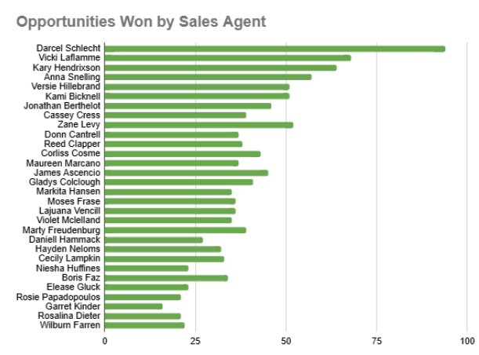
Sales Agent Performance
Top Performers:
Darcel Schlecht: 349 opportunities
Vicki Laflamme: 221 opportunities
Kary Hendrixson: 209 opportunities
Insights:
Darcel Schlecht handled the most opportunities consistently across all quarters, showing a high level of activity and responsibility.
Anna Snelling showed significant fluctuation, with a peak in Q2.
The distribution of opportunities among agents highlights the variability in workload and potential performance metrics for each agent.

Slide 9
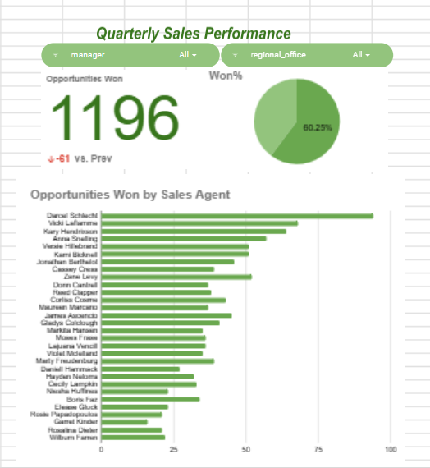

Dashboard
Key Insights
Opportunity Trends:
The overall increase in opportunities from Q1 to Q3 indicates a growing market or improved lead generation efforts, followed by a slight dip in Q4.
Agent Performance:
Darcel Schlecht, Vicki Laflamme, and Kary Hendrixson were the top three performers, handling the most opportunities.
The data can be used to identify top-performing agents and those who may need additional support or training.

Slide 10
Recommendations
Focus on Consistency: Aim to understand the factors contributing to the high win rate in Q1 and replicate these conditions in subsequent quarters.
Agent Training: Use the performance data to tailor training programs for agents who handled fewer opportunities or had lower success rates.
Resource Allocation: Ensure that top-performing agents like Darcel Schlecht are adequately supported to maintain their performance levels.

Slide 11
Thank you
Damilare Talabi | damilaretalabi9@gmail.com| +234 80 245 142 99

